Slide 1
Aprisa SR
Product operation and specifications

Slide 2
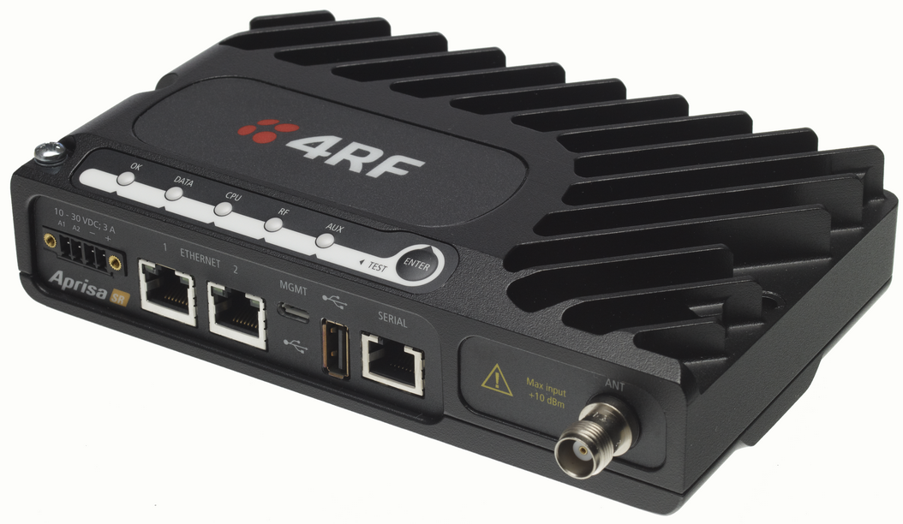
Aprisa SR product operation and specifications
The Aprisa SR has been designed, developed and manufactured to meet the demanding requirements of SCADA communications in critical national infrastructure applications:
  Standards based architecture
  Performance improvement techniques built into software
  Serial and Ethernet interfaces, with support for multiple SCADA protocols
  Industry-leading hardware and intuitive management software
Any well performing network relies on the performance of all its constituent parts. These features combined with coverage and network planning tools combine together for a truly superior SCADA radio solution.

Slide 3
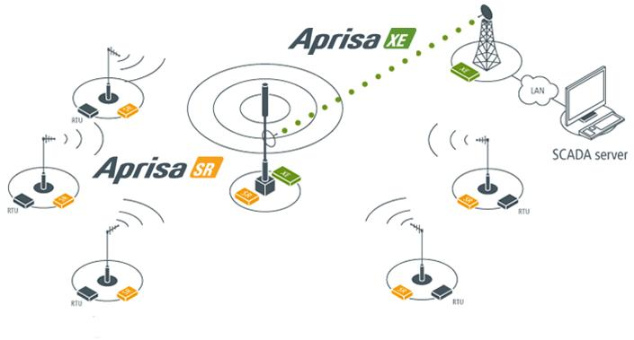
What is the Aprisa SR?
The Aprisa SR is a smart, secure narrowband point-to-multipoint radio used for monitoring and control applications within critical national infrastructure.

Slide 4





Operating modes
The Aprisa SR is a point-to-multipoint digital radio providing secure narrowband wireless data connectivity for SCADA infrastructure and telemetry applications operating in the VHF and UHF bands. Specifically designed to carry a combination of serial packet data and Ethernet data between a base station, repeater stations, and remote stations, each Aprisa SR is configurable as a point-to-multipoint base station, a remote station, or a repeater.
The store and forward repeater operation is a standard Aprisa SR feature enabled using SuperVisor. Messages are transmitted over the air to a designated repeater station where they are received and then retransmitted to the next device.

Slide 5
Key specifications
The key specifications
Topology | Point-to-multipoint; repeater
Frequency bands | 136 – 174 MHz (VHF), 400 – 470 MHz (UHF)
Channel size | 12.5 kHz, 25 kHz
Data rate | 9.6 kbit/s, 19.2 kbit/s
Power Output | 0.01 - 5.0 W (+10 to +37dBm)
Rx Sensitivity (BER<10­²) | -117dBm
Protocols | RS-232 and IEEE 802.3
Modulation | 4-CPFSK
Encryption | 256 bit AES
Temperature | -40 to +70°C
Form factor | 177W x 110D x 41.5H (mm)
Standards | ETSI , FCC, IC, RF, EMC, safety/environmental

Slide 6
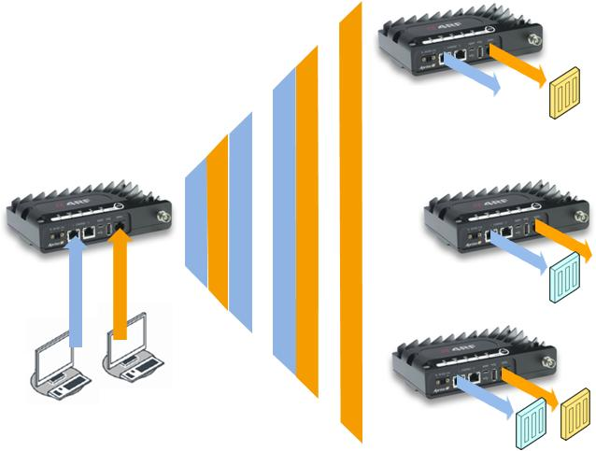
Aprisa SR operation – serial and Ethernet data downlink
Serial and Ethernet data may be carried by the same radio network at the same time; simultaneously addressing legacy and IP based RTU/IED devices. Customer settable priority queuing is used at the base station to schedule serial and IP traffic. The benefit of this approach is the simple upgrade of RTUs from serial to Ethernet.

Slide 7
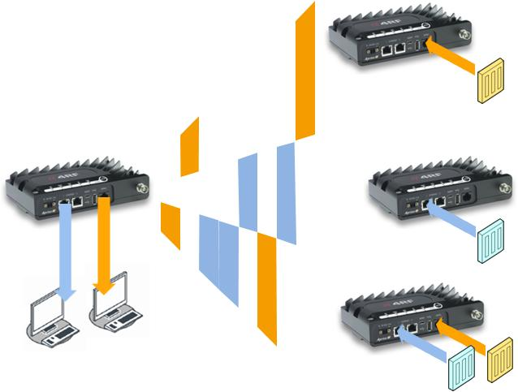
Aprisa SR operation – serial and Ethernet data uplink
Serial data received by a remote station is unicast to the base station. Access to the channel by multiple remote stations is managed using a slotted contention-based MAC process managed using access request / access grant control messages. This improves channel utilisation and network efficiency, particularly in larger networks.

Slide 8
Aprisa SR architecture
The Aprisa SR architecture is based around a layered TCP/IP protocol stack. No special pre-configuration of the interfaces is needed other than management / data selection and serial bit rate selections.
  Application layer: runs proprietary management application software
  Transport layer: runs standard TCP and UDP
  Network layer: standard IP with proprietary automatic radio routing
  Data link layer: the MAC within the data link layer manages end to end data transport between the multiple users of the single wireless channel
  Physical layer: standard RS-232 and Ethernet physical link layers, and a proprietary wireless layer using a one or two frequency half duplex transmission mode. Data is sent over the wireless channel in discrete packets / frames, separated in time. The physical layer provides carrier, symbol and frame synchronisation mainly through the use of preambles, to enable fast synchronisation
Application
Transport
Network
Data link
Physical

Slide 9

Performance improvement techniques: compression
Compression is applied to both serial and Ethernet end user data:
  Essential for efficient data transfer over narrowband channels
  The dynamic table based lossless Lempel–Ziv (LZ) compression algorithm is used to efficiently compress data that has a high proportion of repetitive strings of bytes
  Data stream compression performance is application dependent: text based protocols achieve approximately 50%

Slide 10
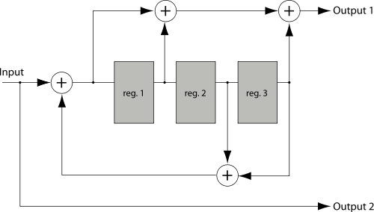
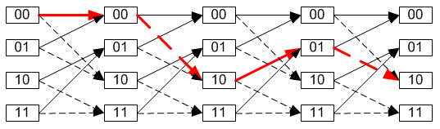
Performance improvement techniques: FEC
Four level continuous-phase frequency-shift keying modulation with FEC is used:
  Phase continuity leads to high spectral efficiency while the constant envelope of the modulation allows high power efficiency class C amplifiers
  Forward error correction (FEC) is applied to all data transmitted over the air using a rate three quarter trellis code: this convolutional code (rather than a block code) enables error correction to be efficiently applied to arbitrary length data which is typical in digital PMR-based SCADA applications
  FEC significantly improves the radio performance in terms of distance and immunity to interference, reflected in the Aprisa SR receiver specifications

Slide 11
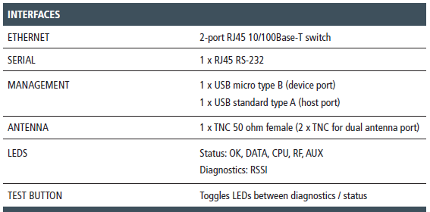
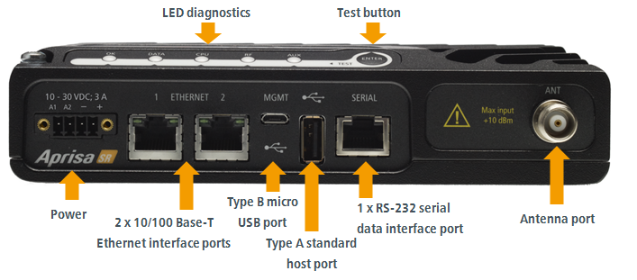
Interfaces
All ports can be used simultaneously providing maximum data transfer functionality. Data on one port can be prioritised over data on another port and the ability to configure a dedicated, Ethernet management port enables the segregation of user and management data.

Slide 12
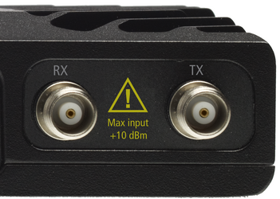
Interfaces: antenna ports
Single antenna port option:
  1 x TNC, 50 ohm, female connector
  Common transmit and receive
  For single frequency with or without band pass RF filter or two frequency working without a filter
Dual antenna port option:
  2 x TNC, 50 ohm, female connectors
  separate transmit and receive, for two frequency working with band pass RF filters

Slide 13
Interfaces: USB and traffic
USB interfaces:
  1 x management port using USB micro type B connector, for product configuration with the Command Line Interface (CLI)
  1 x host port using USB standard type A connector, for software upgrade and diagnostic reporting
Ethernet interface:
  2 x ports 10/100 base-T Ethernet layer 2 switch using RJ-45, for Ethernet user traffic and product management
RS-232 interface:
  1 x RS-232/V.24 port using RJ-45 connector, for asynchronous serial user traffic

Slide 14
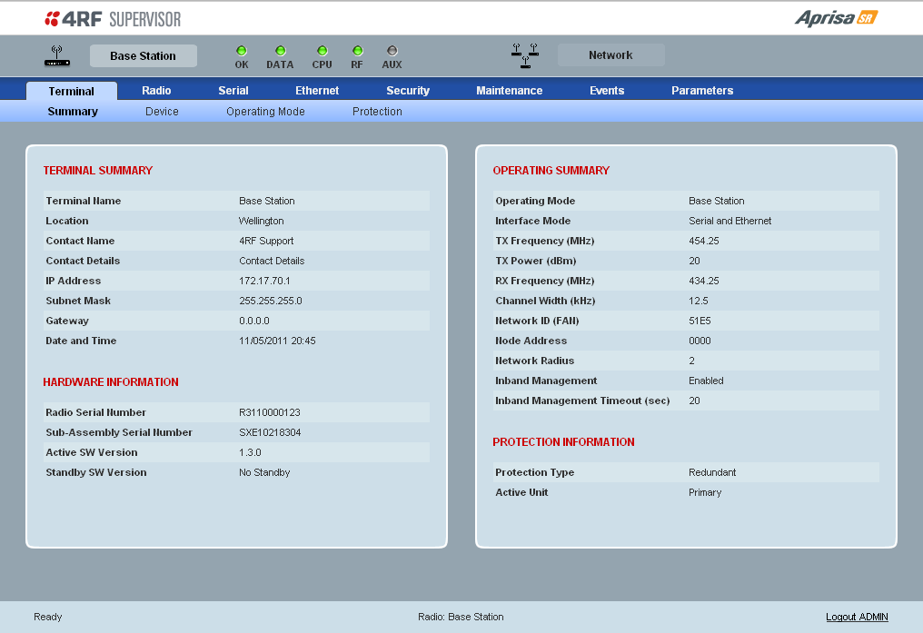
Key software features (1 of 3)
Serial and Ethernet or IP network integration:
  Transparent serial data to support legacy requirements
  No bits are stripped from the RS-232 stream
  Supports multiple SCADA protocols, including DNP3, MODBUS, IEC 60870 - 101, and IEC 60870 -104
  Ethernet (Layer 2) provides simple, easy to set up network integration

Slide 15
Key software features (2 of 3)
Security:
  AES 256 encryption
  Over the air rekeying (in future software release)
  Proprietary wireless framing, FEC, interleaving and compression
  Licensed radio spectrum and robust modulation
  High performance direct conversion receiver
  Segregated management and traffic ports via customer selectable option
  CCM-based data authentication and secured management interface
Detailed alarm and event control:
  Full control over events and alarms, determining what alarms will be reported and what thresholds will drive events

Slide 16
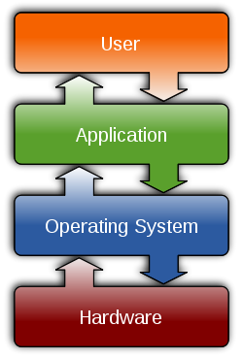
Key software features (3 of 3)
Comprehensive management:
  Local element management, direct connection to radio
  Remote element management, over the air from PC connected to base station
  SNMP proxy for third party network management system: with open standards as a key design goal, the Aprisa SR supports integration with external network management systems such as SNMPc, Netcool, and HP OpenView

Slide 17
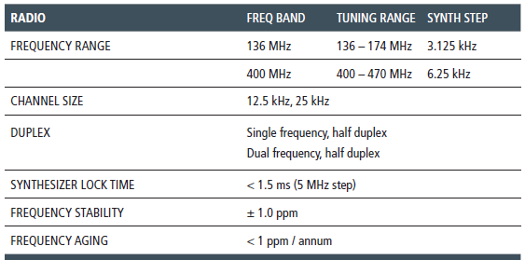

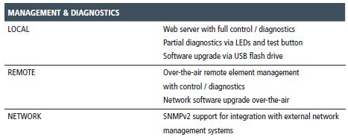
The rest of the specs...

Slide 18
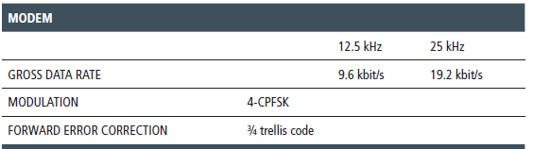

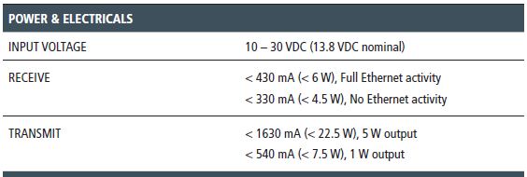
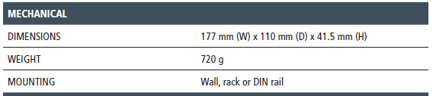
The rest of the specs...

Slide 19
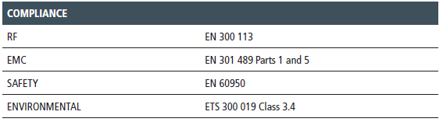


The rest of the specs...

Slide 20
FAQs
FAQ | Operation and specifications
Q. | What SCADA protocols are supported?
A. | The Aprisa SR supports a number of major SCADA protocols including DNP3, MODBUS, IEC 60870 - 101, and IEC 60870 -104. External hardware can be used to support lesser-used protocols if needed.
Q. | How is data prioritised?
A. | A queuing system is used to prioritise traffic from the serial and Ethernet interfaces for over the air transmission. A weighting can be given to each data type and this is used to schedule the next transmission over the air.
Q. | Are any protocols stripped out to assist with over the air capacity?
A. | No – the Aprisa SR transports data transparently.

