Slide 1
Aprisa SR
Case studies and deployments

Slide 2
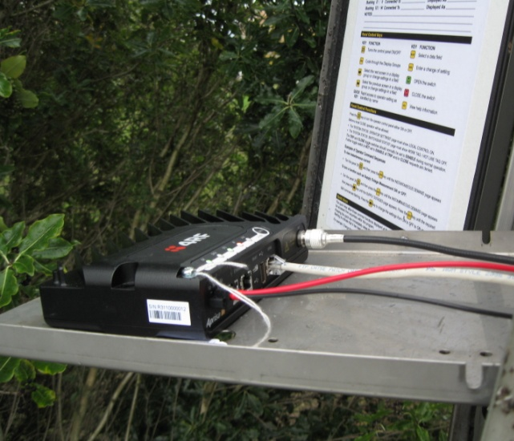
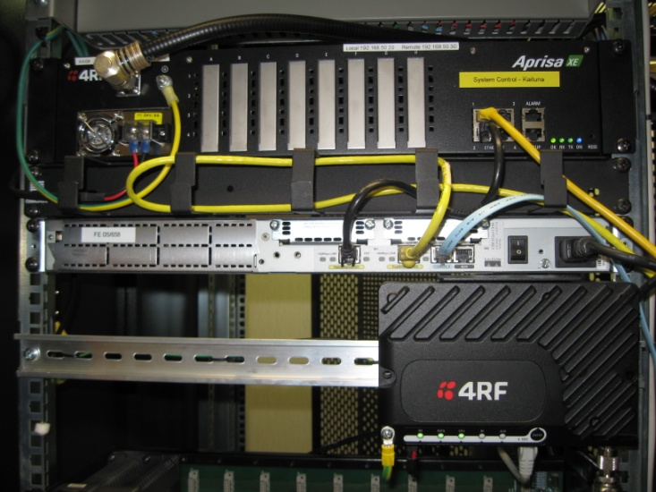
Aprisa SR case studies and deployments
The Aprisa SR is a new product addressing the SCADA space. In the short time since launch, 4RF has achieved enviable deployments with utility and government infrastructure projects across Europe, Oceania and Latin America. Illustrative case studies include:
WEL Networks: electricity utility in New Zealand
CRE: electricity utility in Bolivia
Masterton Water: water utility in New Zealand
Marlborough Lines: electricity utility in New Zealand
Ministry of Defense, Slovenia

Slide 3
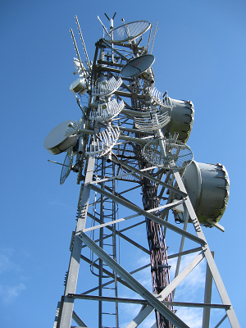
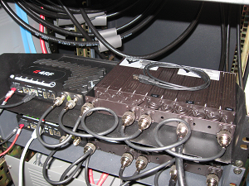
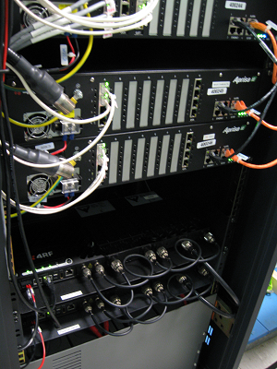
Case study: WEL Networks (1 of 2)
WEL Networks Limited (WEL) is an electricity infrastructure provider, distributing electricity services to over 84,000 homes, businesses, and organisations throughout the Waikato region in the North Island of New Zealand. WEL owns, develops and maintains the network of lines, substations and associated infrastructure. The company has more than 5100 kilometres of lines and has an annual throughput of over 1160 Gigawatt hours.
WEL is installing a new wind farm as part of its renewable energy commitment of 90% renewable energy by 2025. A new SCADA communications project is being implemented using both the Aprisa SR and Aprisa XE.

Slide 4
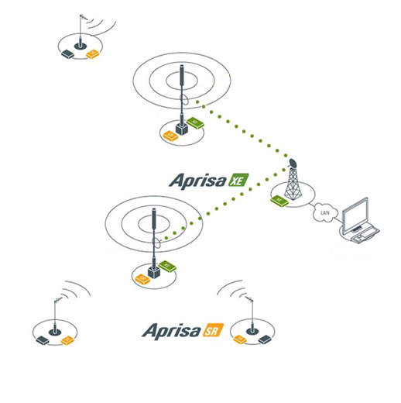
Case study: WEL Networks (2 of 2)
The WEL network contains:
An Aprisa XE radio link from the SCADA master controller to the radio tower, connected to an Aprisa SR base station at the radio tower
External filter/ duplexer combination to ensure interference-free RF operation, because the Aprisa SR base station is located at a shared RF high site
Aprisa SR remote stations located at the 33 kV ring main entry points to the electricity network, where the RTUs are situated to monitor and control the switching equipment
The SCADA traffic is DNP3 over IP, polled every hour and configured for report-by-exception. Additional Aprisa SR radios are currently being deployed to connect poletop reclosers, transformers, regulators and substations.

Slide 5
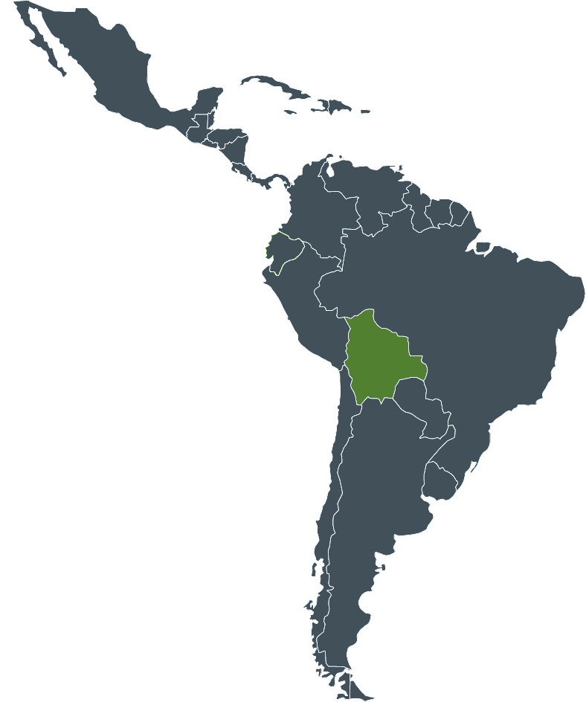
Case study: CRE Bolivia
CRE distributes electricity to 225,000 customers in the city of Santa Cruz city and rural communities in the south east of Bolivia.
It has to date installed 16 Aprisa SR radios, in base station, repeater and remote station configurations.
The Aprisa SR units are being used to control the reclosers in the medium voltage distribution network. A variety of RTU makes and models are being supported, including:
Schneider Talus 200P
Schneider Talus 200E
Cooper Power brand, RTU F6
All the RTUs use the IEC 60870 5-101 protocol.

Slide 6
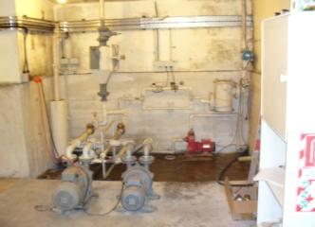
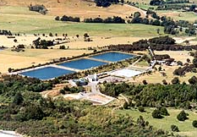
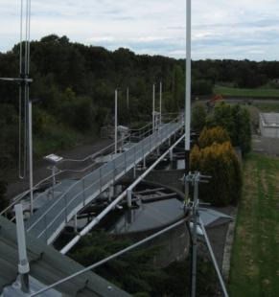
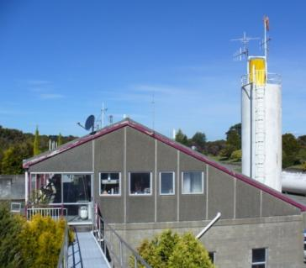
Case study: Masterton Water treatment plant (1 of 2)
The Masterton water treatment plant supplies a population of almost 20,000 customers, mainly residential. It processes between 9 and 25 million litres of water every day.
The network operations centre for the SCADA network is located at the treatment plant. This is where all information received from the local and remote RTUs is collected, analysed, acted upon and archived.
An Aprisa SR base station was installed at the treatment plant, with remote units at the siphon intake (4 km upstream) and boost pumps.

Slide 7
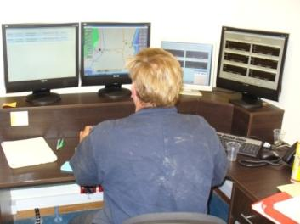
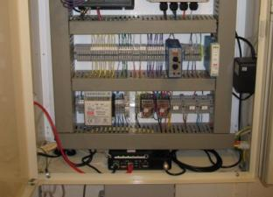
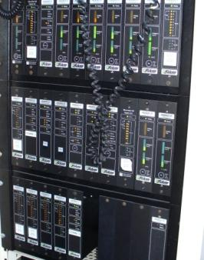
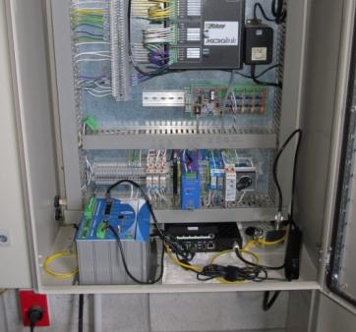
Case study: Masterton Water treatment plant (2 of 2)
The SCADA equipment at the siphon intake monitors the river level, the pipe flow and the pumps. At the boost pump, used when water pressure and gravity are insufficient, there is a pump control PLC and the water clarity is measured.
RTUs are configured to communicate via High level Data Link Control (HDLC) over UDP Ethernet to the SCADA master. Data is passed transparently via the Aprisa SR radio network. The RTUs are polled every minute from the base station and all data is visible in the HMI on the SCADA Master. Every 30 minutes all stored data is downloaded from the RTU to the SCADA master.

Slide 8
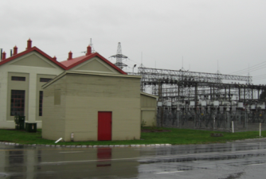
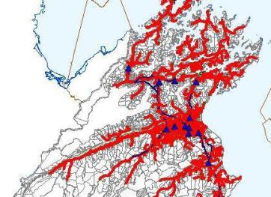
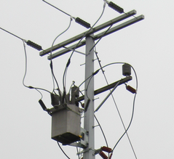
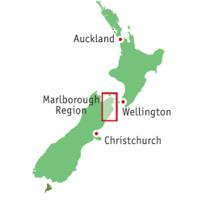
Case study: Marlborough Lines (1 of 2)
Marlborough Lines is an electricity distribution company, covering more than 11,000 square kilometres. The company receives 33kV supply from national grid operator Transpower, and distributes 372 GWh of electricity to 23,900 consumer connections, mainly domestic and small-to-medium commercial.
Assets range from new to over 80 years old. Its SCADA network monitors and controls substations, distribution transformers and pole top reclosers. A variety of communications methods are used, including CDMA, fibre, leased lines, unlicensed radio and the Aprisa XE point-to-point link.

Slide 9
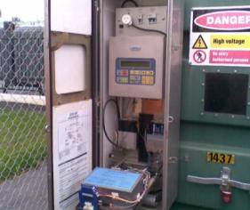
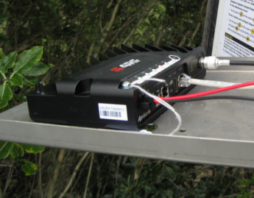
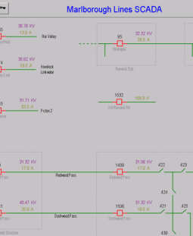
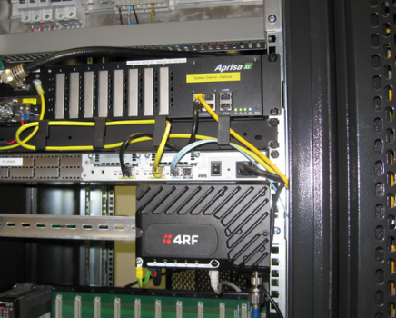
Case study: Marlborough Lines (2 of 2)
Example deployment: an Aprisa SR remote station was installed at a pole top recloser on the 33 kV connection from the national grid. It was housed in the weatherproof cabinet, linking a Nu-Lec pole top recloser to the SCADA master service located at the systems control centre, using the DNP3 protocol. A lightweight dipole antenna was used. The Aprisa SR base station was installed in the communications room with other equipment. The system was operational and integrated into the SCADA software application in less than two hours, polling the remote station every three seconds.

Slide 10
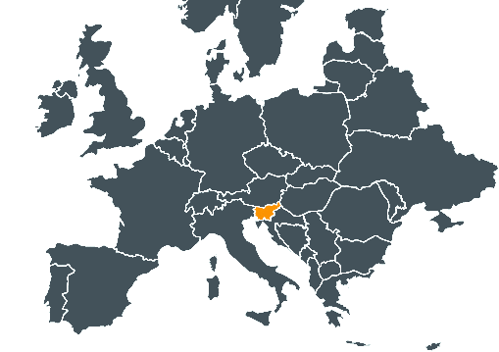
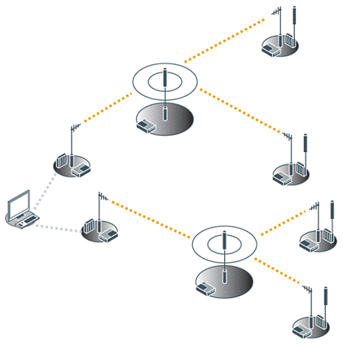
Case study: Ministry of Defense, Slovenia (1 of 2)
The requirement:
Replacing pager backhauling network for Slovenia’s Ministry of Defense
The challenge:
Easy installation needed: many remote sites and mountainous terrain
Challenging environmental conditions, with below freezing temperatures
Increased speed and security were essential
The result:
Used the same channels as the analogue system being replaced
78 radios deployed, many repeaters
Longest link was 56.7 km
Secure and robust system for public safety application
Pager transmitter
Omni
Aprisa SR
Aprisa SR repeater
Pager transmitter
Aprisa SR
Aprisa SR
Pager transmitter
Omni
Paging centre
Aprisa SR
Pager transmitter
Aprisa SR repeater
Aprisa SR

Slide 11
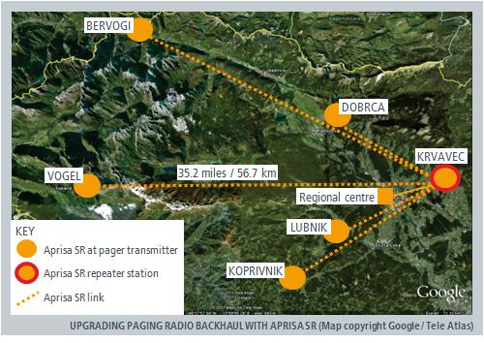
Case study: Ministry of Defense, Slovenia (2 of 2)
All the radios were deployed by IT-100 without the need for direct support from 4RF. The network was simple to install and provides the Ministry with the level of robustness needed for their mission-critical emergency call paging network despite the challenges presented by the mountainous terrain and remote location of the paging stations.
The Ministry is now expanding the network to include a total of 78 Aprisa SR radios made up of 14 base stations, 16 repeaters, and 48 remote stations.
““The Aprisa SR is perfect for long distance UHF links in mountainous areas. It is simple to install and program, and provides good security and high robustness.”
Joze Stuflek, Managing Director, IT-100.

