Slide 1
Aprisa SR
Network configuration and management

Slide 2

Aprisa SR network configuration and management
The Aprisa SR has been designed specifically for the real world deployments of utilities. It incorporates the flexibility, tools and software that make the network easy and fast to deploy, configure and manage:
  Initial set up specifications pre-configured
  Flexible, simple mounting options
  Use of lightweight antennas
  Local LED display to aid antenna alignment
  Automatic remote station registration
  Intuitive ‘point and click’ management software
  Multiple mechanisms for radio management
  Easy software upgrade process
  Integration with third party network managers
The right solution saves time and energy

Slide 3
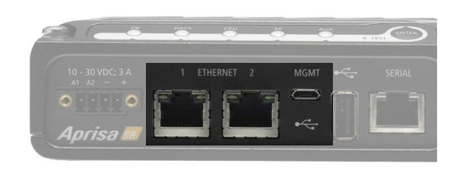
From the factory to the field
The Aprisa SR is shipped with a factory
default configuration including:
  IP address
  Frequencies and power
  Interface settings
There are two methods of radio configuration:
  Using the SuperVisor management interface over an Ethernet connection: all settings can be customised simply and intuitively
  Using a terminal emulator such as Windows® HyperTerminal connected via the micro USB connection to access the command line interface (CLI) designed for engineering access to low level functions

Slide 4
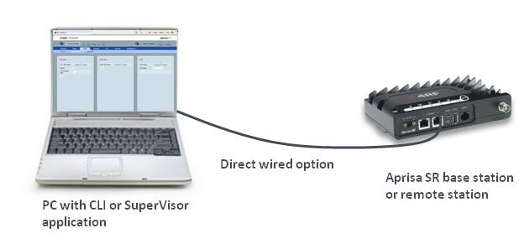
Local direct connection
Local element configuration is carried out by directly connecting to the Aprisa SR unit via the Ethernet port, using the embedded web server and graphical user interface, or via the dedicated management port and using the command line interface. This is compatible with a Windows® PC.

Slide 5
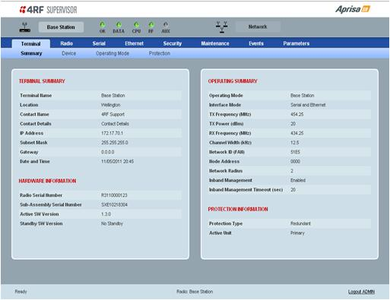
SuperVisor application
The SuperVisor web-based management application offers a comprehensive, easy to use GUI to make network configuration and management easy.
Once a secure connection is established, using HTTPS via the Ethernet port, a web browser enables viewing and configuration of all radio settings and parameters with a simple ‘point and click’ functionality.
SuperVisor also provides performance monitoring and alarm information.
The clear, easy to follow layout greatly improves fault identification and isolation and increases Aprisa SR radio asset visibility.

Slide 6
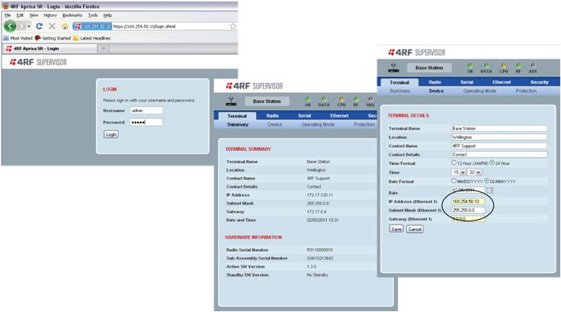
Basic configuration
* Aprisa SR radios can be reconfigured in the field: all units can be any of a base station, remote or repeater
The factory defaults of the Aprisa SR require minimal configuration via SuperVisor prior to installation. The required basic configurations for each unit are:
  IP address
  Frequencies: both transmit and receive
  Operating mode: base station, remote station or repeater*

Slide 7
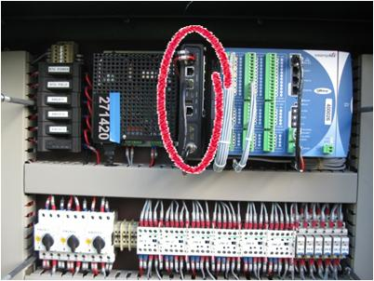
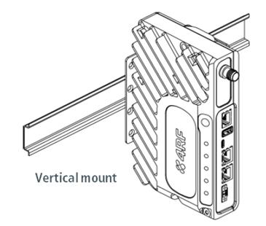
Installation and mounting
The Aprisa SR can be quickly and easily installed, with advanced mounting options for complex sites:
  DIN rail
  19 inch rack
  Direct wall mount
The Aprisa SR can be mounted at any orientation, and the diagonal heat sink provides efficient cooling in all positions.
Vertical DIN rail mounting provides efficient use of space in small roadside cabinets

Slide 8
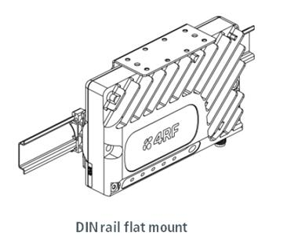
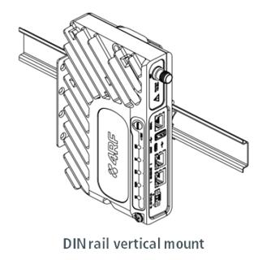
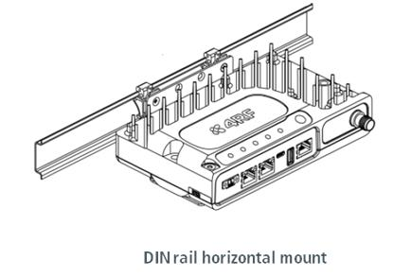
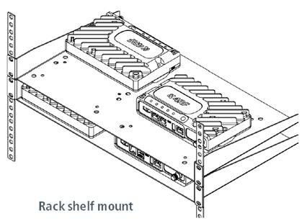
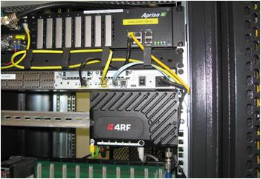
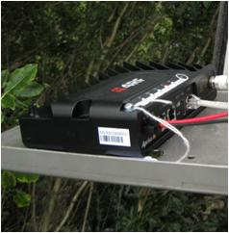
Installation and mounting

Slide 9
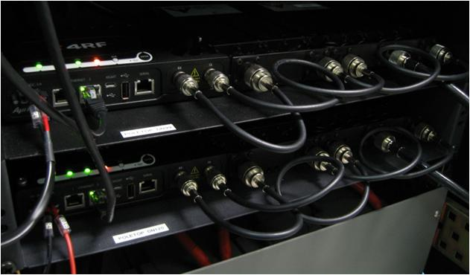
Radio and optional filter mounting
Installations requiring filters and duplexers can be mounted on a 19 inch rack accommodating both the filters and the radio.

Slide 10
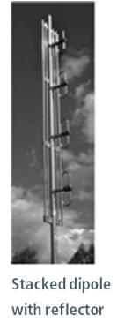
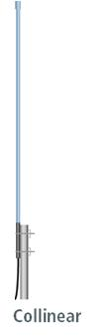
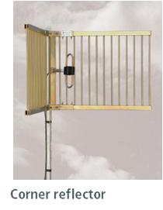
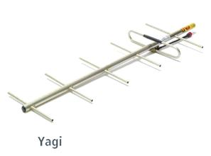
Antenna options
An Aprisa SR network can use a combination of antenna options.
At base stations and repeaters:
  Collinear or dipole omni-directional antenna providing 360 degree coverage
  Semi-directional stacked dipole with reflector providing 180 degree coverage
At remote stations:
  Directional antenna providing less than 90 degree coverage: dipole, Yagi or corner reflector

Slide 11
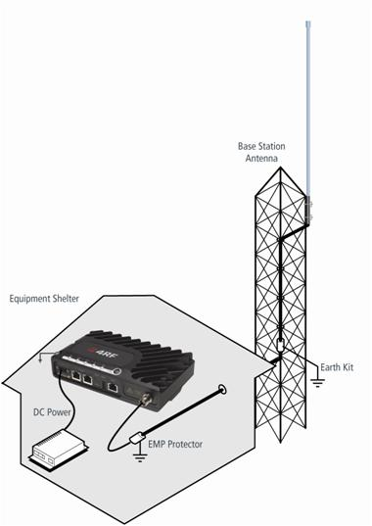
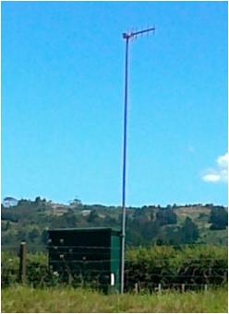
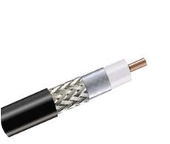
Antenna and feeder installation
The lightweight antennas are easy to mount to a variety of mast and tower types.
The other elements of the Aprisa SR installation that are required are:
  Earthing strap
  Lightning arrestor (EMP protector)
  DC power supply
  CNT 400 or similar feeder

Slide 12
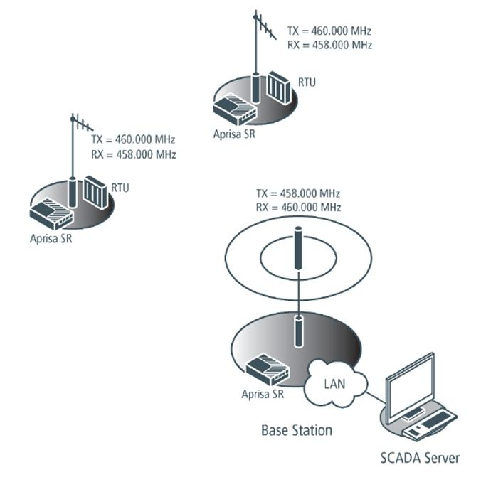
Power on and start-up
The first Aprisa SR that is installed is the base station. After the licenced frequencies are set, the base station waits to ‘hear’ from any remote radio wanting to join the network.
When a remote station is powered on it transmits a broadcast message. The base station receives this message and registers the remote on to its network.
Additional remotes are then added as required, using the same automatic registration process.

Slide 13

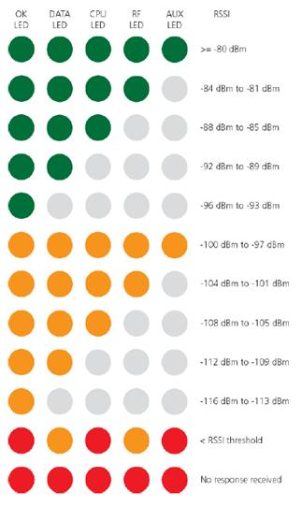
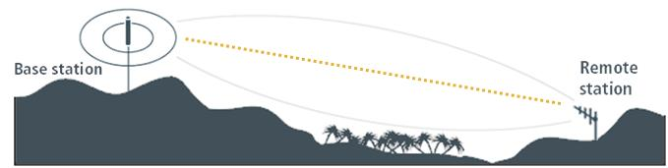
Antenna alignment
The LEDs on the front of the Aprisa SR enable the antenna alignment to be checked and corrected without the need for any test equipment. The remote station transmits a test packet request message to the base station. The base station replies with a packet that the remote station can use to measure the receiver signal strength, displayed on the LED panel.

Slide 14
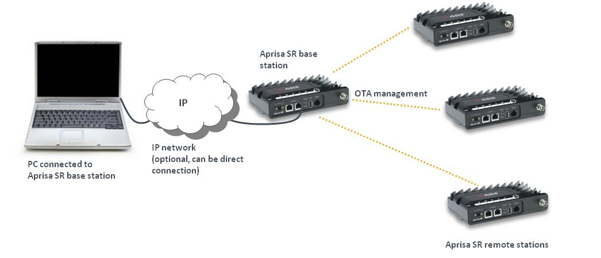
Managing the Aprisa SR network from the base station
Remote management of all terminals in the network is possible from the base station. Via the secure HTTPS login to the base station, SuperVisor can be used to monitor and configure all elements in a network.

Slide 15
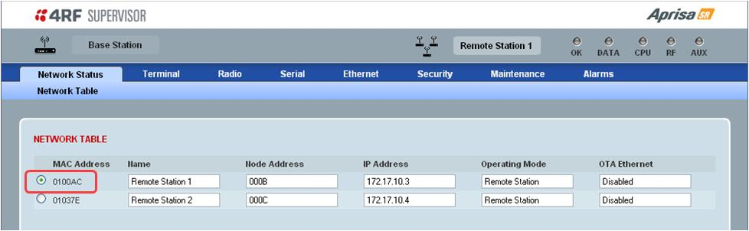
Network table
Within SuperVisor a Network Management Table lists all the remote and repeater stations that are registered with the base station. The parameters of the remote station are viewed by selecting the required radio from the list and clicking on the remote station icon on the top, right hand side of the window.
Once connected, SuperVisor regularly polls the remote station for status information which is automatically displayed. This polling time can be configured and the default time is 10 seconds.

Slide 16
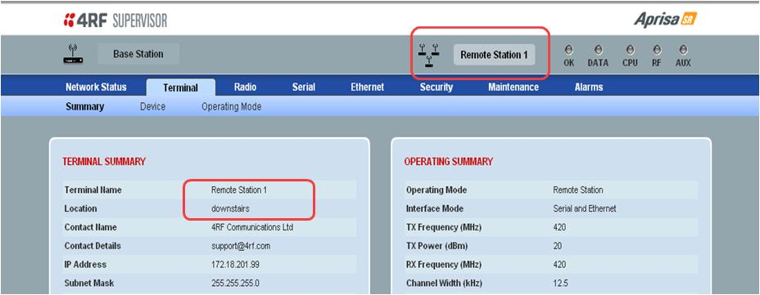
Managing terminals
SuperVisor follows a set format for consistency and ease of use. Each group of settings has a read-only summary screen which provides a quick overview of the key radio and operational parameters.
Navigation through the configuration windows is via the menu tabs at the top of the frame. Wherever possible, drop down menus, radio buttons and pre-configured values are used to limit the data that needs to be entered by the end user; thus saving data entry time and reducing potential errors.

Slide 17
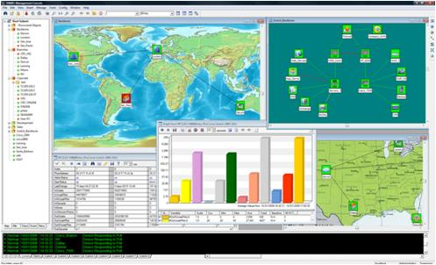
Integration with external network management systems
The Aprisa SR supports integration with external network management systems such as Castle Rock Communications’ SNMPc, Netcool, and HP OpenView. SNMP management is supported via a network manager connected to the wired Ethernet port of the Aprisa SR base station.
The radio supports network management discovery where new devices within the network are polled automatically and it is possible to manage both a fully featured or serial only radio via SNMP network management.
Further information is available about SNMP management.

Slide 18
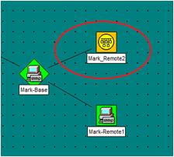
Network management system functions
The Aprisa SR supports a number of network management functions:
  Event traps
  Access controls
  Community strings with read/write access or read access
All diagnostic information is available for read access, and diagnostic alarms generate SNMP traps. Configuration settings are available for read/write access management. All traps are time-stamped by the radio on which the traps are generated.
The Aprisa SR supports two modes of addressing for gathering SNMP data: a direct addressing scheme and a proxy addressing scheme.

Slide 19
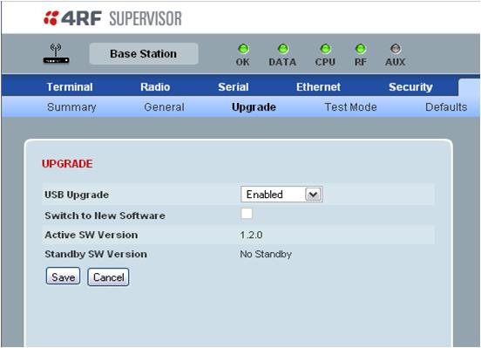
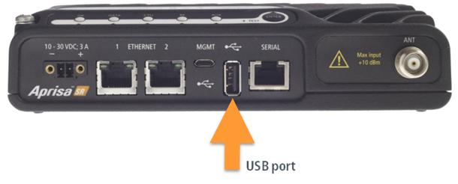
Radio software upgrade
Radio upgrades are easy to perform by plugging a USB flash drive into the host port when the radio is off, then unzipping the software release files.
The software release files are encrypted using XXTEA to prevent maliciously hacked versions of Aprisa SR firmware from being loaded. The Aprisa SR will not accepted unencrypted firmware files.
Notes:
If the upgrade process fails, it could be caused by:
The Aprisa SR is already operating on the version of software on the USB flash drive.
The SuperVisor USB Upgrade setting may be set to “Disabled” (see “Maintenance Upgrade” on page
90). The new software will not have uploaded to the Aprisa SR. The USB Upgrade setting must be
set to „Enabled‟ or „Authenticate‟ and the upgrade procedure repeated.
The SuperVisor USB Upgrade setting may be set to “Authenticate” (see “Maintenance Upgrade” on
page 90). The new software will have uploaded in to the Aprisa SR but will not have activated.

Slide 20
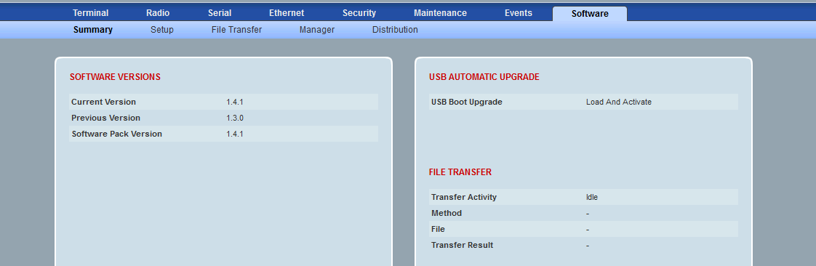
Over the air software upgrade
Software upgrades can be implemented from the base station
All repeater and remote stations within the Aprisa SR network can be upgraded
Upgrade process is controlled via SuperVisor
  Dedicated menu items for software distribution and management
Minimum disruption to end user data
Removes the need for individual site visits
Notes:
If the upgrade process fails, it could be caused by:
The Aprisa SR is already operating on the version of software on the USB flash drive.
The SuperVisor USB Upgrade setting may be set to “Disabled” (see “Maintenance Upgrade” on page
90). The new software will not have uploaded to the Aprisa SR. The USB Upgrade setting must be
set to „Enabled‟ or „Authenticate‟ and the upgrade procedure repeated.
The SuperVisor USB Upgrade setting may be set to “Authenticate” (see “Maintenance Upgrade” on
page 90). The new software will have uploaded in to the Aprisa SR but will not have activated.

Slide 21
FAQs
FAQ | Network configuration and management
Q. | Can one Ethernet port be prioritised over another?
A. | No. Management, Ethernet and serial traffic can be prioritised but both ports have equal weight for the same type of traffic.
Q. | Can a base station carry both serial and Ethernet remotes simultaneously?
A. | Yes, it can.
Q. | Why does the Aprisa SR have two Ethernet ports?
A. | Two separate Ethernet ports provides a major advantage when configuring or monitoring units in the field, because the radio does not have to be disconnected, and so traffic flow is uninterrupted. Base stations, repeaters and remote station radios can also be configured and managed over the radio link using the SuperVisor web-based GUI application

