Slide 1
Aprisa SR
Transitioning from legacy serial to IP

Slide 2
Transitioning from legacy serial to IP
The world is migrating from the use of legacy serial protocols and network infrastructure through to IP-based systems.
The benefits of IP, and IP SCADA networks, are becoming clearer. However, IP also brings additional security concerns that need to be addressed.
Equally clear is the fact that this migration will not happen immediately. Vendors need to support users with equipment that is both backwards-compatible and future-proof.
The Aprisa SR has been designed with this future-proof approach in mind. Plan for the future, protect the past. The best of both worlds.
How far along the road are you?
“The speed of technology change in the telecommunications market is high compared with utility technology. Utilities expect asset life of up to 40 years. This exposes utilities to risk of obsolescence and associated cost of maintaining obsolete technologies.” [EON, EUTC 2009]

Slide 3
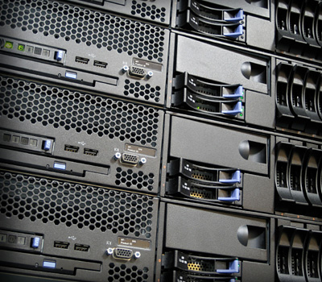
What are the benefits of an IP SCADA network?
For utilities and SCADA, using IP has a number of benefits:
Network interoperability between devices
Over-the-air control of remote devices, e.g. SNMP
Reduced requirement to visit remote sites
Ease of interface to modern PC and server systems
Common cabling systems
The migration to IP is not solely related to the benefits of IP: regulatory pressure or government cyber security concerns may mandate a security upgrade of existing serial network.
Past infrastructure roll-outs have considered communications last. Critical equipment is selected first then then a supporting network designed. Moving to IP allows installation of network connectivity first, with the knowledge that all IP equipment choices can be supported.

Slide 4
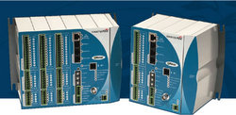
SCADA equipment is evolving to support IP
The benefits of IP mean that the latest generation of SCADA remote devices* are IP based, with many advantages:
Low cost, reliable, and scalable
Widely accepted, a proven standard
Network compatibility and interoperability
Multiple applications share network resources (however, this does present a possible security issue)
Ubiquity, use over virtually any physical medium
However, there is a huge deployed base of older generation SCADA systems using serial RS-232/V.24.
Network infrastructure, including radio devices, therefore needs to work with a huge range of SCADA equipment.
* SCADA devices: remote terminal unit (RTU) or intelligent electronic device (IED)

Slide 5
Why is a future-proof approach essential?
The complexities of the real world mean that this migration from serial to IP cannot take place immediately:
Not all SCADA equipment can be economically replaced in a single ‘forklift’ upgrade
Some specific types of sensor may not have IP interfaces while newer devices may not support serial connection
This results in a combination of both new IP and legacy serial SCADA devices in the field
Communications infrastructure needs to support this combination of serial and IP devices, as well as ensuring an upgrade path between the two and simultaneous support for both.

Slide 6
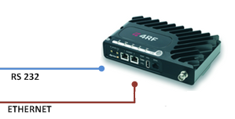
How does the Aprisa SR make this easy?
The Aprisa SR provides a means to mix legacy serial and modern IP SCADA elements in one unified network: even serial devices can be connected via IP using the terminal server feature.
Additional benefits include:
The advanced 360 degree security measures provided by the Aprisa SR allow older devices to be secured by ‘wrapping’ unsecured traffic into a securely protected radio infrastructure
The network management features of the Aprisa SR enable visibility of remote sites as an integral part of the radio

Slide 7
An aside on the security issues with IP
Use of an IP network contributes to security concerns:
Using IP is not the same as sharing with the Internet but they share the same protocols and interconnections need very careful management
Even when fully isolated the use of IP provides a standard interface for an attack is physical access is possible
This is one of the reasons why the Aprisa SR incorporates such comprehensive security mechanisms.

Slide 8
Benefits of the future-proof approach
With lengthy deployment cycles and a huge legacy asset base, the future-proof approach of the Aprisa SR provides a number of benefits:
Migration from serial to IP at your own pace
Integration of new communications infrastructure into current network topologies
Upgrade units from serial to IP as needed
Support for multiple SCADA protocols
Software upgradeable for long term deployments over the life of the network
“Utility cables last 100 years, transformers 30-60 years, overhead lines 40 years. So when a utility buys: it’s not for Christmas, it’s for life.”... ESB Networks, 2010

