Slide 1
Aprisa SR
RF performance and reliability

Slide 2
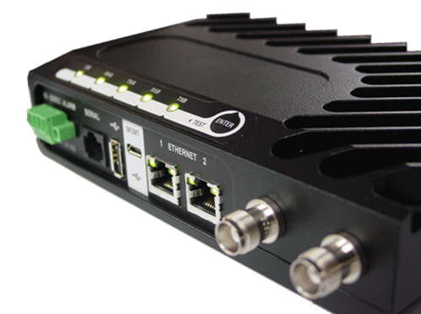
Aprisa SR RF performance and reliability
4RF has a history of designing high performing, highly reliable radio products, and the Aprisa SR is no exception.
The Aprisa SR incorporates a number of key design features to provide its unbeatable reliability.
RF performance is unbeatable, with attention paid to every element of the design: transmitter, receiver, modulation and efficiency.
The Aprisa SR has been carefully designed to meet the complex RF and physical environment that today’s utilities need to operate in.
With distance engineering built into every Aprisa SR, it outperforms other products.

Slide 3
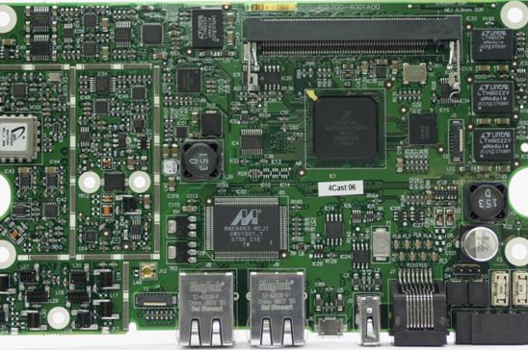
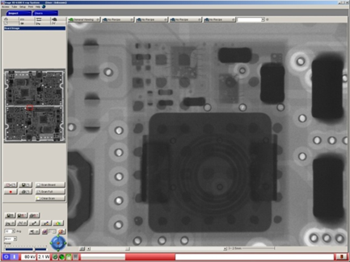
RF design and reliability
At 4RF the radio frequency (RF) performance is always excellent, the key to the competitive advantage of the Aprisa SR.
The Aprisa SR combines a number of key design features to ensure its reliability:
  No manual component tuning: full electronic tuning over the entire RF band
  No moving parts
  Single ‘uniboard’ PCA
High output power and continuous operation at +70 °C is made possible by:
  High efficiency amplifier technology
  Extensive integrated passive heat sinking

Slide 4
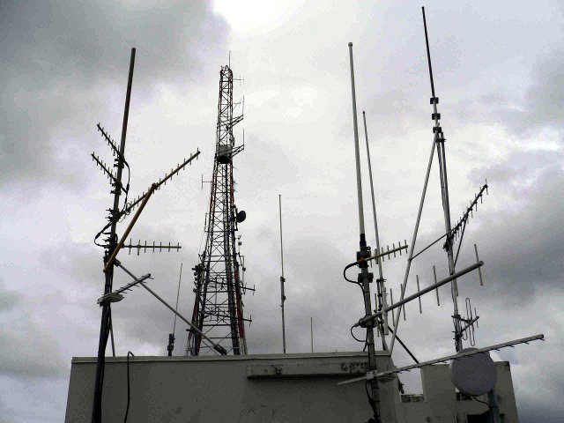
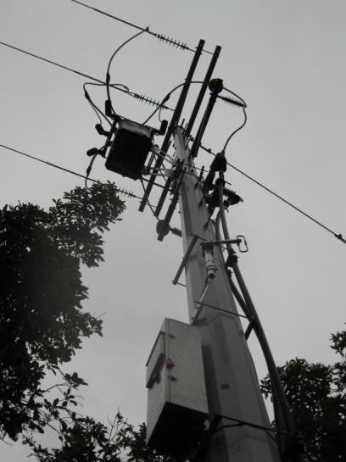
The RF environment
Aprisa SR radios use digital modulation for
point-to-multipoint applications and operate in sometimes crowded bands shared with land mobile and other applications.
The Aprisa SR needs to handle multiple strong signals while receiving co-channel signals with highly varying signal strengths.
Both of these factors drive the receiver design requirements.
Why does it need to be small?
  The small design leads to lower cost, better reliability and easier manufacture
  Space is often restricted in SCADA applications, such as pole mounted systems

Slide 5
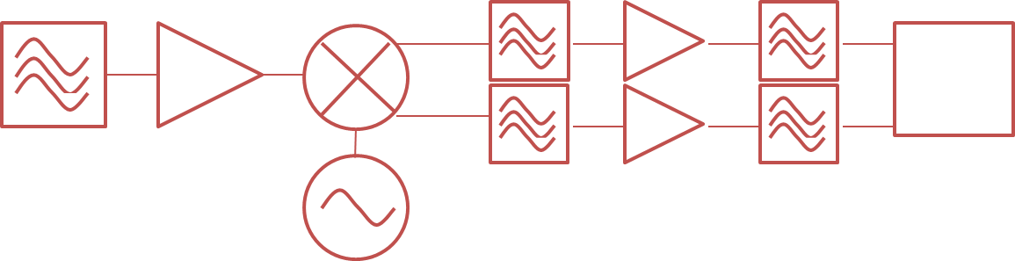
Technical performance
Excellence in transmitter design:
  The Aprisa SR transmitter uses IQ direct modulation architecture along with a highly efficient MOSFET power amplifier to maximise the power efficiency of the radio
  All spurious and transient emissions have been optimised to exceed the stringent ETSI standards and to minimise dead time in the transmit receive switching process
Excellence in receiver design:
  The Aprisa receiver uses a direct IQ demodulator combined with low loss and high rejection performance baseband filters which provide the high dynamic range that is needed to exceed the stringent ETSI specifications
  ETSI sensitivity performance is easily achieved along with base station interference protection ratios

Slide 6
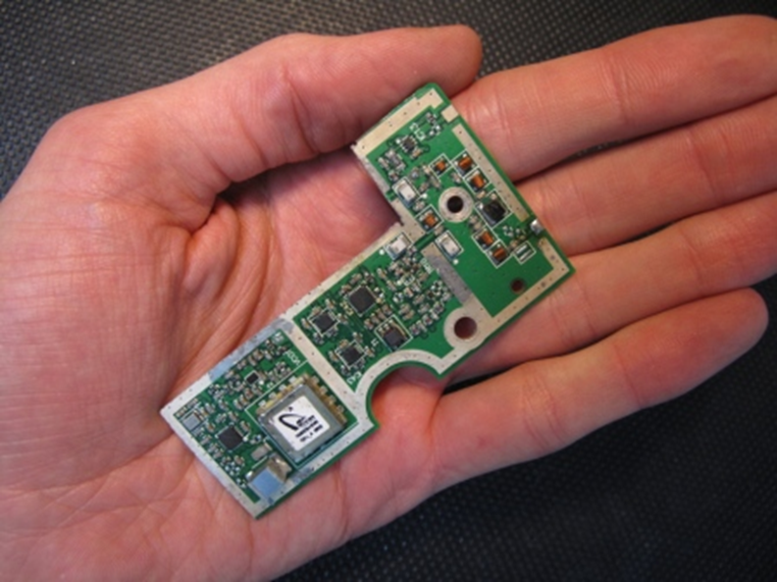

Base station: RF performance in the palm of your hand
The Aprisa SR features a carefully balanced design that meets key performance goals within a tight cost and power consumption envelope.
Power consumption
Cost
RF performance

Slide 7
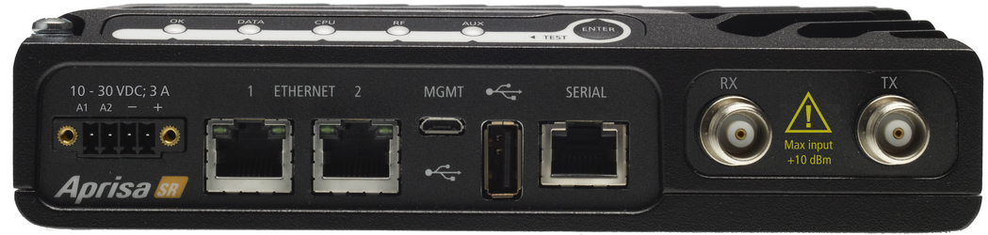

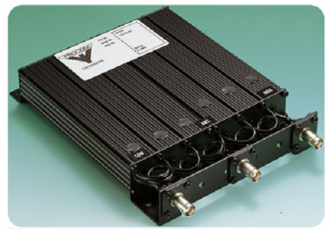
The role of duplexers
At many of today’s crowded base station sites, shared with broadcast and LMR transmitters, signal levels are so strong and so closely spaced that additional filtering is needed.
The RF performance of the Aprisa SR mitigates overload and intermodulation, but for the worst cases the Aprisa SR provides separate transmit and receive antenna connectors to support external duplexers or filters. Compact duplexers are available for both VHF and UHF models.
Do competing products use these?
  Yes, this is not unique to the Aprisa SR
  Duplexers are used in most cases where another transmitter is installed at the same location in the same band

Slide 8
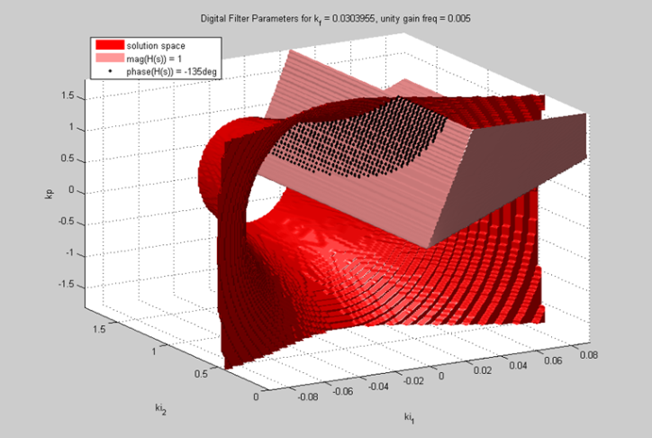
Modulation performance
The Aprisa SR uses 4-CPFSK modulation:
  4-level, continuous phase, frequency
  shift keying
  Very reliable and offers good spectrum
  efficiency
Forward error correction (FEC) is used:
  Rate ¾ trellis coding FEC combats
  transmission errors from noise, greatly
  improving the sensitivity performance of the radio which results in fewer retries
  Improves performance on difficult, high-loss paths
The unique microcontroller based adaptive demodulator is insensitive to temperature and process variations for reliable through-life performance.

Slide 9
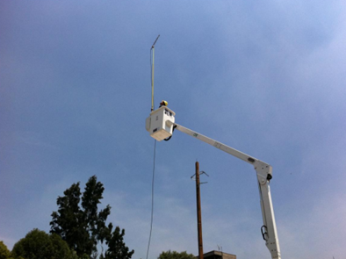

Field data demonstrating superior performance
CFE holds the monopoly electricity transmission and distribution in Mexico and is the largest electricity utility in the CALA region.
Mexico City is a highly dense environment with many path obstructions and interference making radio operation a challenge.
CFE tried radios from their existing supplier but were unable to maintain reliable links to a number of sites.
CFE successfully tested the Aprisa SR over the same paths!

Slide 10

Network efficiency
The Aprisa SR uses two key efficiency measures.
With payload compression:
  All end-user and management data passed
  over the Aprisa SR network is compressed,
  both serial and Ethernet, up to 50%
  This provides a significant advantage for large
  packets and file transfers
With proxy addressing:
  The network manager only requests data from the Aprisa SR base station
  The base station broadcasts the SNMP data request across the network
  To reduce the traffic across the network an efficient over-the-air protocol is used to broadcast the SNMP messages
More usable bandwidth is delivered for customer applications while still supporting network management systems.

Slide 11
FAQs
FAQ | RF performance and reliability
Q. | What, if any, impact does FEC have on the throughput of the radio?
A. | While FEC creates a necessary overhead it improves the ability of the Aprisa SR to operate successfully at the network edges and in coverage areas inside the network that are difficult due to interference or geographic conditions.
Q. | Why are there versions of the Aprisa SR with two antenna ports?
A. | The Aprisa SR operates in half duplex. Versions with either a single antenna or separate transmit and receive ports are available to allow for common antenna working with filters in situations where other transmitting equipment is located at the same site.
Q. | Does the device support dynamic power control of the transmitter?
A. | As with other similar SCADA radio equipment the Aprisa SR radio does not support ATPC.

