Slide 1
Aprisa SR
SNMP and SNMPc from Castle Rock Computing

Slide 2
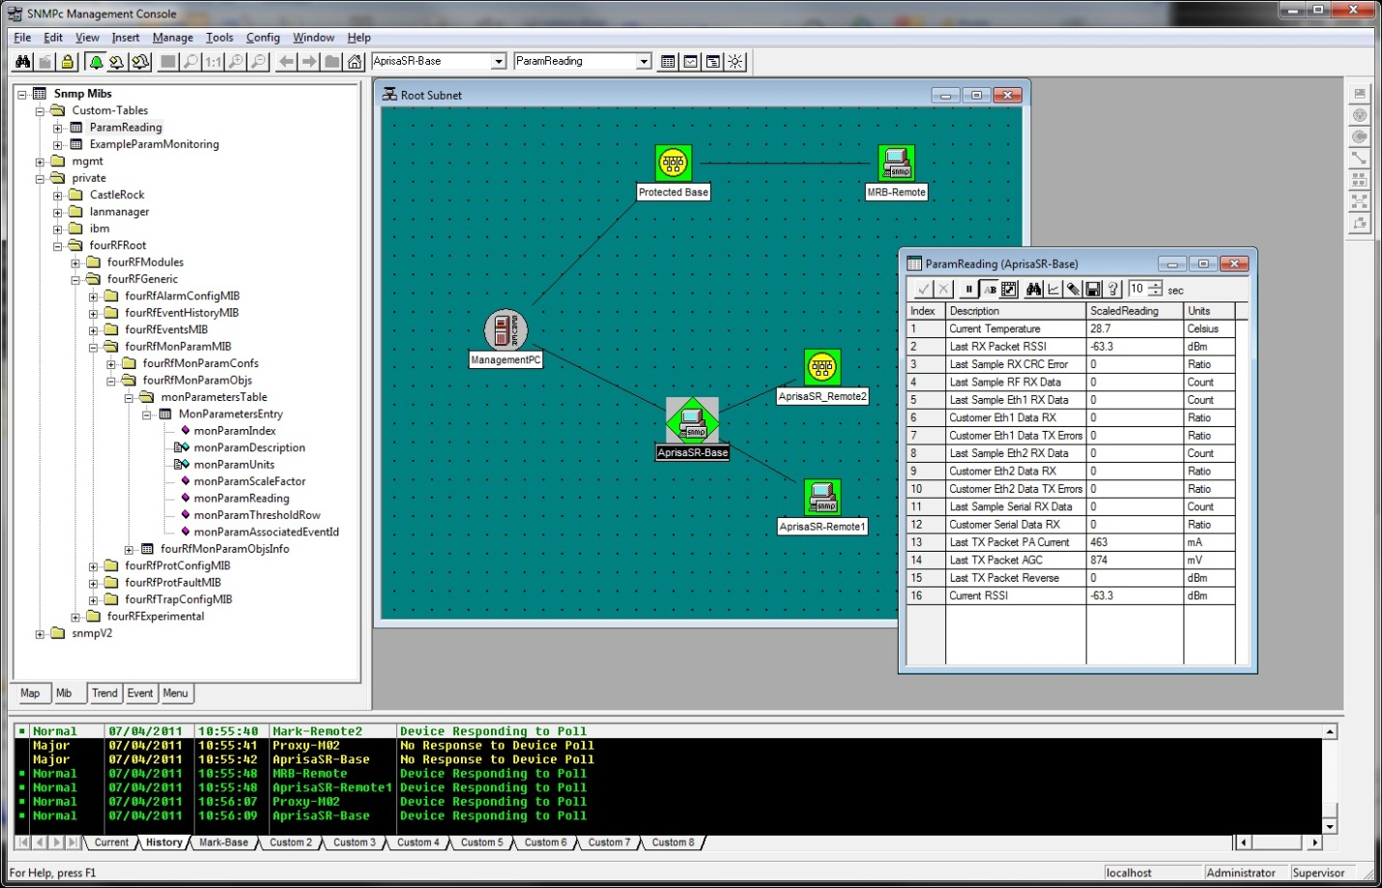
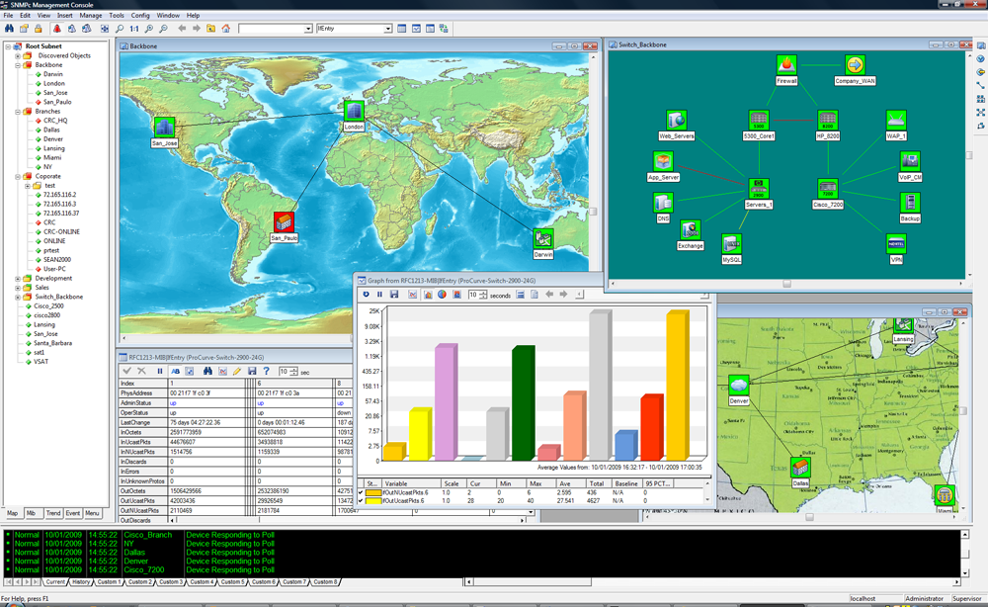
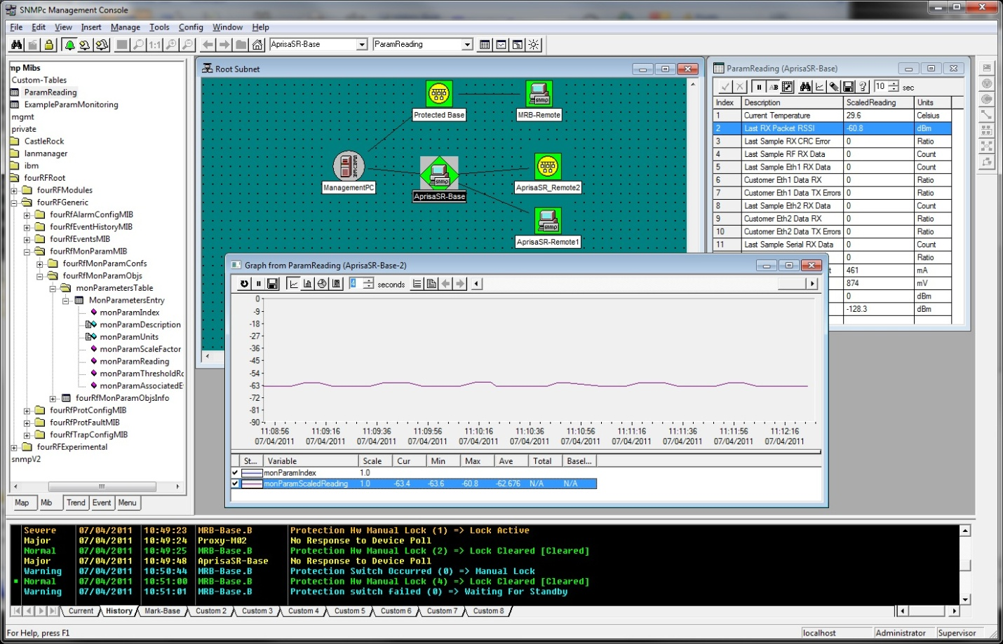
Aprisa SR SNMP and SNMPc
The standards based design and development of the Aprisa SR means that it supports the use of third party network management systems that use SNMP.
4RF uses SNMPc from Castle Rock Computing. With the Aprisa SR MIB configurations compiled into SNMPc, the management system can be used to visualise, monitor and manage the Aprisa SR network, as well as gathering and displaying performance statistics.

Slide 3

What is SNMP?
SNMP is the simple network management protocol, a unified, open standard, supported by a wide range of vendors. SNMP standard RFC 1213 was developed by the Internet Engineering Task Force (IETF). SNMP:
  Is an Internet-standard protocol for managing devices on IP networks
  Enables devices to be monitored over a network from a central location, and flags conditions that need administrative attention
  Allows a common means to gather statistics and network health independent of propriety configuration or monitoring tools such as SuperVisor

Slide 4

More about SNMP
A key part of the SNMP system is the management information base (MIB), a hierarchical ‘library’ that describes the available parameters and how they can be read or set via SNMP.
There are many SNMP software applications available. 4RF recommends and supplies SNMPc from Castle Rock Computing.
Network management systems, like SNMPc, often drive larger applications, ‘managers of managers’, via a northbound interface, to support enterprise-wide management.

Slide 5
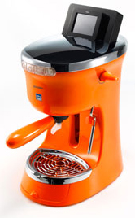
Why use SNMP?
The advantage of SNMP is that it provides a standard means to manage devices, making sense of complex networks.
An SNMP management application is a central application that monitors available information from devices attached to a network:
  Vendor independent – any device that supports SNMP can be part of the network
  Device independent – Aprisa SR, Aprisa XE, routers, switches, computers, servers, power supplies, RTUs can be monitored
  Supports swift responses to events or outages
  Provides a common visual representation of device conditions and statistical analysis of device parameters
  Managers usually provide advanced alerting capabilities such as email or SMS when events occur, allowing technical staff to respond
Fugo SNMP-enabled
coffee machine

Slide 6
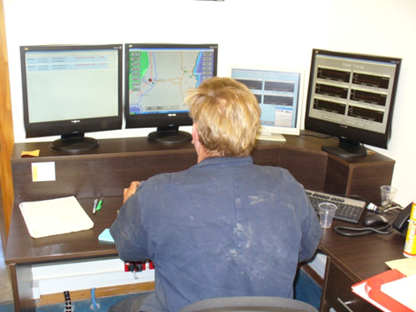
Network operations centres
SNMP managers, such as SNMPc, can be used in small to medium scale systems while ‘managers of managers’, such as Netcool from IBM, are used in large systems, gathering and collating reports from other managers.

Slide 7
SNMPc home page
SNMPc enables the operator to visualise, monitor, and manage an Aprisa SR network.

Slide 8

Why Castle Rock Computing SNMPc?
SNMPc is a scalable network management system application from Castle Rock Computing suitable for small to medium size enterprises. 4RF provides the SNMPc as its preferred SNMP software tool for Aprisa SR (and Aprisa XE) networks.
SNMPc can be run on a single PC in a Microsoft® Windows PC environment for small systems or expanded with server components for larger configurations.
In addition to common management functions SNMPc provides:
  A map mnemonic to help visualise the network geographic layout
  Event notifications via email or SMS to engineers or helpdesk staff
  Polling, reporting, and scripting – network performance and service availability can be monitored with scheduled reports driven by customer specific scripts
  OEM and demonstration versions

Slide 9
Aprisa SR actions and alarms with SNMPc
The Aprisa SR supports SNMP version v2c RFC 1213. Once the Aprisa SR MIB modules have been compiled they become visible in the SNMPc MIB Browser, allowing the management application to view or set the element parameters that are specified in the MIB. These parameters can be displayed in tables or graphs.
If an alarm or other event occurs, the Aprisa SR sends a message trap to notify the SNMP server. The required alarm trips can be configured in the Aprisa SR using the SuperVisor management application or via SNMP itself. Standard and customer definable tools are provided by SNMPc to enable defined actions to be taken for each type of reported fault condition.
As well as checking internal faults, integrating the Aprisa SR with SNMPc means that site conditions can be monitored, for instance:
  A temperature of more than 35°C could indicate an overheating machine room
  An Ethernet or serial port not receiving data within a certain time could indicate possible RTU failure or disconnection

Slide 10
Element table format
The parameters of individual elements can be viewed in table format.

Slide 11
Parameter graphing
Selected parameters can be graphed – for example RSSI or temperatures.

Slide 12
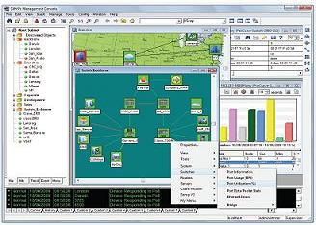
Statistics gathering
SNMPc can be configured to regularly poll any device in the network, including Aprisa SR radios, and record the key parameters specified in the MIB files.
These key parameters can be selected and plotted over time to provide a clear indication of system performance.
SNMPc can be scheduled to automatically generate daily, weekly, and monthly statistical reports in a variety of formats including graphs, bar charts, and summaries.
Reports can be exported to destinations including printers, files, or to a web server.

Slide 13

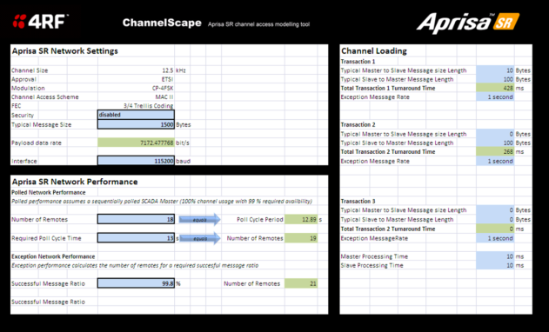
Other SNMP and SNMPc considerations
The standards based design philosophy of the Aprisa SR means that the network can be managed using virtually any SNMP manager.* When using SNMPc, like any other network management application, some customisation and set up work is required, the extent of which will depend upon the individual deployment.
The impact of statistics gathering needs to be factored into the network design, since SNMP messages and traps use part of the available radio capacity and extensive SNMP polling or statistics gathering can impact on SCADA traffic delivery. Tools such as 4RF ChannelScape can help to determine capacity limits.
* 4RF uses SNMPc from Castle Rock Computing, and does not support other third party systems

Slide 14
FAQs
FAQ | SNMP and SNMPc
Q. | Can the Aprisa SR be used with any SNMP manager and if so what does the customer need for this to work?
A. | The Aprisa SR will work with virtually any SNMP compliant manger. Customers simply need the freely available Aprisa SR MIB to enable operations.
Q. | If a customer buys SNMPc can it be used to manage equipment from other vendors?
A. | While most customers will prefer separate management platforms for different applications it is perfectly possible to mange all devices from one platform.
Q. | Has 4RF integrated the Aprisa MIBs with other vendors’ management systems?
A. | Yes, Aprisa XE radio are integrated in the management platforms of several vendors.
Q. | Are coffee machines really able to be managed with SNMPc?
A. | Absolutely. See also IETF standard RFC 2324 - Hyper Text Coffee Pot Control Protocol.

