Slide 1
Aprisa SR
Coverage, path, and network planning

Slide 2
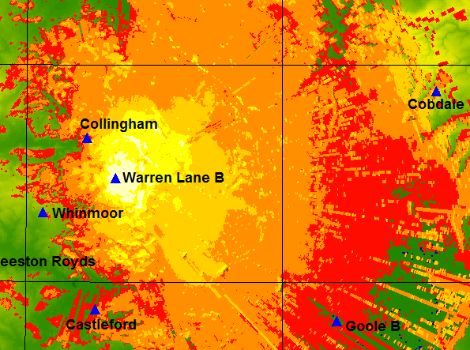
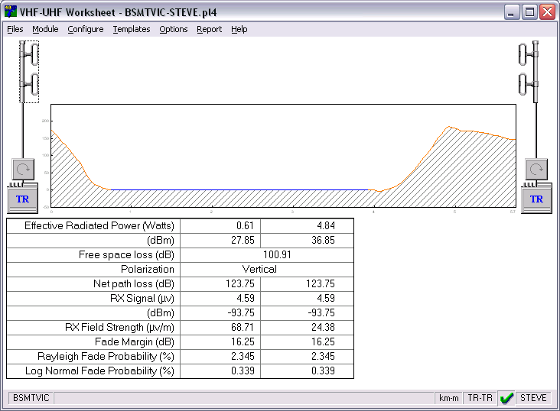
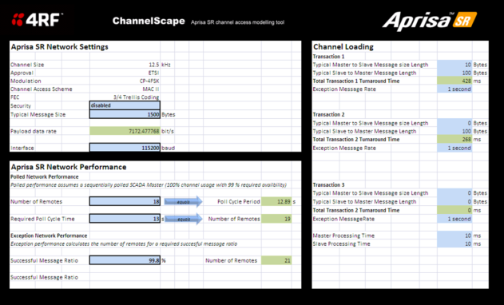
Aprisa SR coverage, path, and network planning
The Aprisa SR is designed to solve SCADA communications problems. Successful problem solving requires planning.
Planning the point-to-multipoint SCADA radio network means that network topology and performance can be optimised prior to equipment deployment. Planning activities help with:
  Selecting site locations
  Antenna selection
  Use of repeaters
Planning tools for the Aprisa SR include Pathloss 4 and Aprisa ChannelScape.

Slide 3
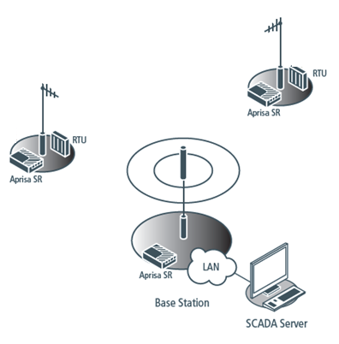
Deployment considerations
Aprisa SR base stations communicate with remote units, often more than 50 for a single base station*. A link can be greater than 60 km, depending upon the terrain. Topographic features, such as hills, mountains, trees, foliage or other path obstructions (buildings) can limit radio coverage.
Overall network performance will be determined by a number of factors including the geographic location, the number of remote stations, and the traffic profile across the network. For effective network operation the designer will plan the loading such that the total number of remote stations is distributed across the available base stations to ensure optimum geographic coverage and preserve network capacity.
* An Aprisa SR base station can support up to 500 outstations. However in a real world deployment, the number of outstations is dictated more by RF propagation and the traffic profile than by a limit set by software.

Slide 4
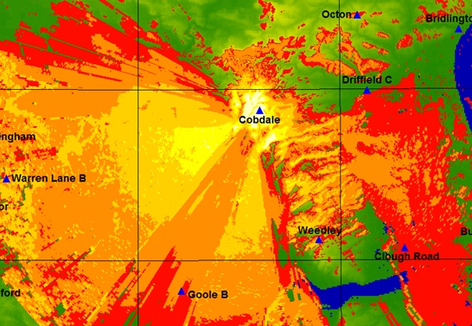
Site selection and Pathloss 4 Network Coverage
All remote stations need to be able to see the base station, unless repeaters are to be used. Coverage plots are ideal for planning deployments, to understand the coverage from the proposed base station sites. Such plots are useful for new networks, replacement networks, and to check the performance of existing sites.
4RF uses the Network Coverage software module for Pathloss 4 from Contract Telecommunication Engineering Ltd to create coverage plots*. This provides a graphical interpretation of the expected coverage of a site. The prediction provides estimated signal levels that can then be used for the selection of antenna types and gains.
* customers may use other third party tools for coverage estimate, although these tools are not supported by 4RF

Slide 5

Pathloss 4 Network Coverage plots for Warren Lane B
Contour colour criteria
Level 1
-76dBm
Light yellow
Level 2
-86dBm
Yellow
Level 3
-96dBm
Dark yellow
Level 4
-106dBm
Orange
Level 5
-113dBm
Red
Notes:
Warren Lane B has coverage calculated as a base station using an omni antenna

Slide 6
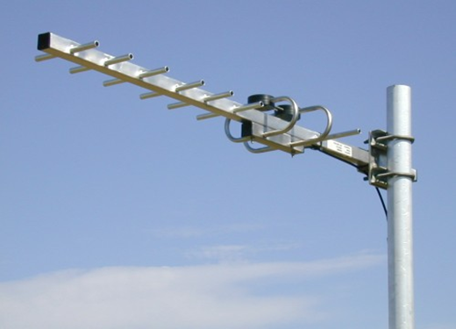
Antennas
Antennas need to be chosen to suit coverage and regulatory requirements, and their selection is an important consideration in network planning:
  Selection is influenced by the distribution of the remote sites relative to the base station
  Regulatory agencies may specify antenna patterns and gains to suit EIRP signal power limits
  Base stations located in the centre of the coverage area will require an omni-directional antenna
  Base stations located at one end of the coverage area will require directional antennas
  Good frequency re-use and reduced susceptibility to interference is promoted by using directional antennas at remotes sites

Slide 7
Pathloss 4 path profiles
Individual paths can also be analysed to determine the suitability of site locations, either existing or proposed.
Calculated signal levels will determine the appropriate system hardware, such as:
  Antenna size
  Antenna height
  Transmitter power
  Feeder type
  Link availability
  Antenna azimuth

Slide 8





Planning for use of repeaters
It is not always possible for a base station site to directly reach all required remote station locations. In this situation, coverage can be extended with the use of the ‘store and forward’ repeater option*. Any Aprisa SR unit can be configured as a repeater using the SuperVisor management application. In repeater mode:
  Messages are transmitted over the air to a repeater station where they are received and then re-transmitted to the next device
  The capacity of a path with a repeater is halved due to an effective doubling of the latency for the connection through a repeater: this must be taken into account when planning the network capacity
* Some regulators may not allow the use of repeaters: local regulatory requirements should be consulted when network planning.

Slide 9

Aprisa SR ChannelScape customer modelling tool
With point-to-multipoint products such as the Aprisa SR it is necessary to understand how capacity is shared between the remote stations in a network. Most SCADA networks rely on base station polling of remote stations initiated by the SCADA server computer equipment. ChannelScape takes Aprisa SR parameters such as channel bandwidth, security settings, and interface types to predict polled and exception network performance results.

Slide 10
FAQs
FAQ | Coverage, path, and network planning
Q. | How many units can be linked to an Aprisa SR base station?
A. | An Aprisa SR network can support up to 500 devices (remote or repeater stations) within one single field area network (FAN). The ChannelScape modelling tool allows the number of outstations to be estimated.
Q. | What range is possible?
A. | The range depends on site and antenna selection. Ranges in excess of 60 km are possible.
Q. | Can all traffic types be transported simultaneously?
A. | An Aprisa SR network carries three traffic types: (1) management, (2) serial RS232 and (3) Ethernet. All three of these traffic types are queued, buffered, and effectively multiplexed on to the same wireless channel. All three of these traffic types can be transported simultaneously enabling the transport of both serial SCADA protocols (IEC 60 870.5.101) and Ethernet SCADA protocols (IEC 60 870.5.104) on a single network.
Q. | What else needs to be taken into account?
A. | The SCADA network design and topology will be defined by the application. For example, a single network consisting of six serial IEC 60 870.5.101 RTUs and six IEC 60 870.5.104 RTUs can be designed and SCADA messaging can be appropriated to provide acceptable network availability.

